Slide 1
Lesson 2 Chapters 3-4
Classes
Data types
Method overriding
Decision making
Creating objects
Arrays
Loops

Slide 2
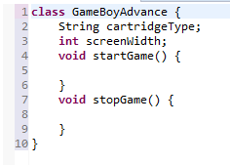
Classes
There is only one GameBoyAdvance class, but there can be many instances.
These are called objects.
Each object can have a different state.
Attributes define state
Methods define actions

Slide 3
Data Types -Variables
Must be declared before use
Can be declared as
Attributes of a class
Arguments to a method
Variables inside a method
Can be assigned
Can be modified
Can be passed as arguments to methods

Slide 4
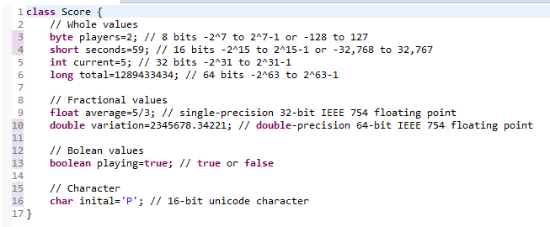
Primitive data types

Slide 5
Operations
+ : Addition
- : Subtraction
* : Multiplication
/ : Division
% : Remainder
++ : Increment
-- : Decrement
! : Not

Slide 6
Conditions
== : Equal to
!= : Not Equal to
> : Greater than
>= : Greater than or equal to
< : Less than
<= : Less than or equal to
&& : And
|| : Or

Slide 7

Inheritance
Not every animal can swim, so fish is a specific kind of animal
We use the keyword extends to indicate this

Slide 8
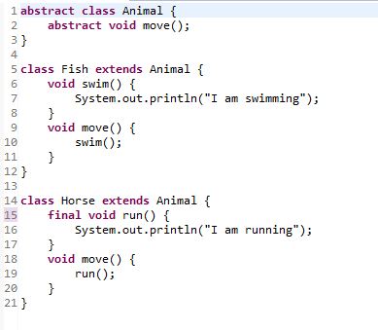
Method override
Use final to prevent override

Slide 9
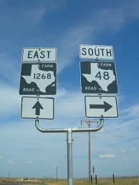
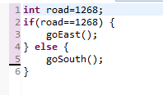
Making decisions

Slide 10
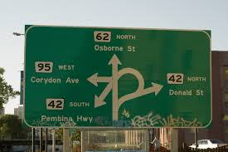
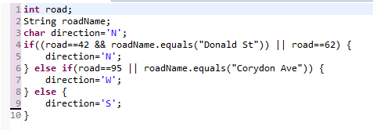
Combining conditions
|| or && : Only do second part of needed
| or & : Always do second part
Watch out!
= : Assignment
== : Condition

Slide 11
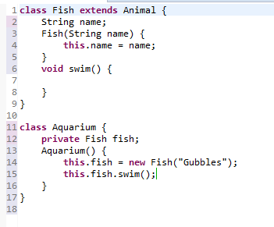
Constructors
Constructors are methods
Have same name as the class
Keyword ‘new’ calls a constructor.

Slide 12
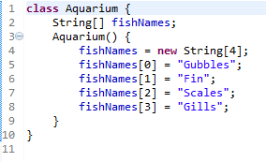
Arrays
First index is 0.
You can specify a literal
array in curly braces.
Has a fixed size.
All objects have the same type

Slide 13

Loops - for

Slide 14

Loops - for indexed

Slide 15
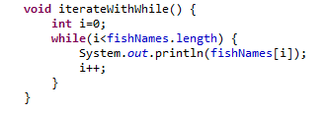
Loops - while

Slide 16
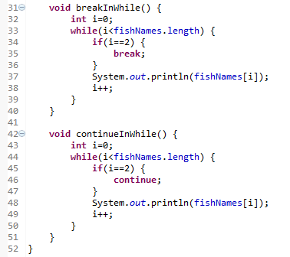
Loops - break and continue
‘break’ goes out of the loop
‘continue’ goes back to the
beginning of the loop
Do you see the problem?
Since variable ‘i’ is never
Incremented, the loop runs
forever.

Slide 17
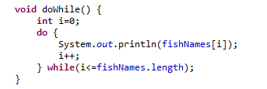
Loops - do while
Do first, validate after
Careful! This kind of loop will always run at least once.

